Slide 1
Hamming code(4 bit data)

Slide 2
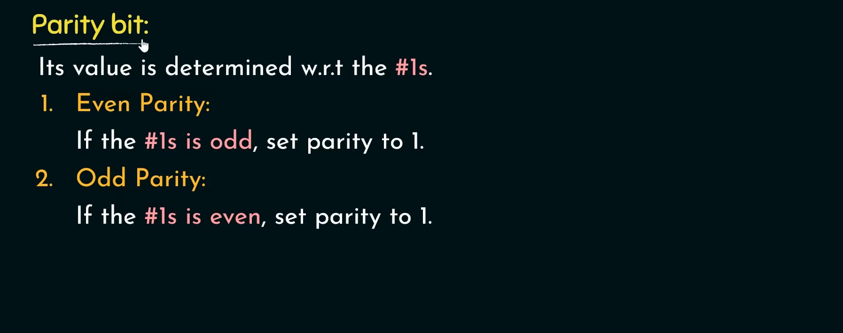

Slide 3
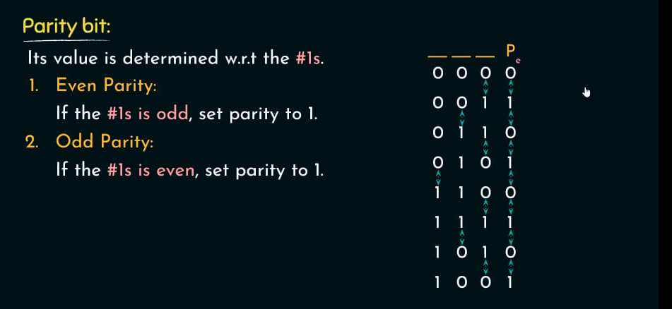

Slide 4
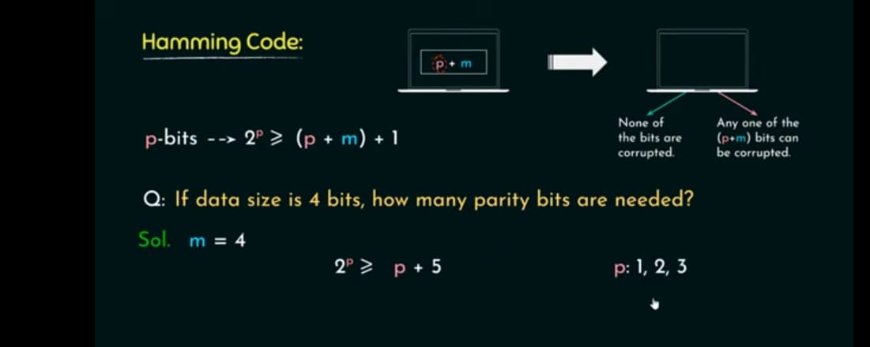
Problems using Hamming Distance and Parity

Slide 5
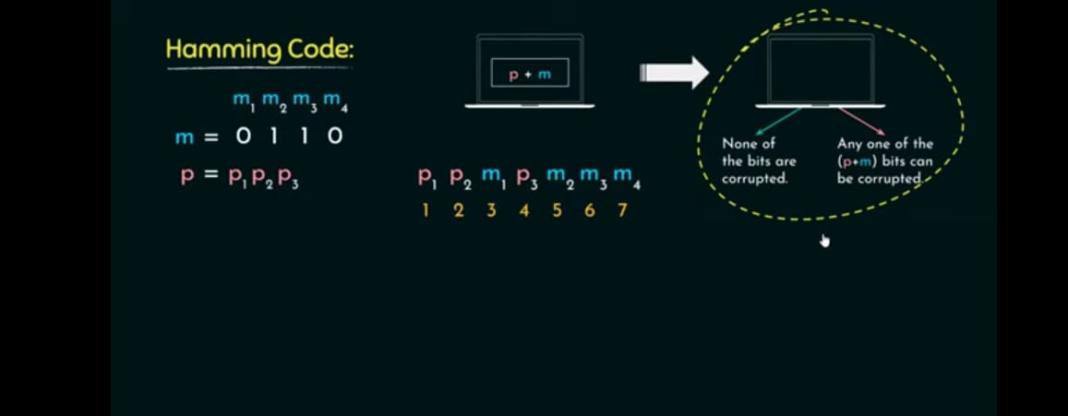

Slide 6
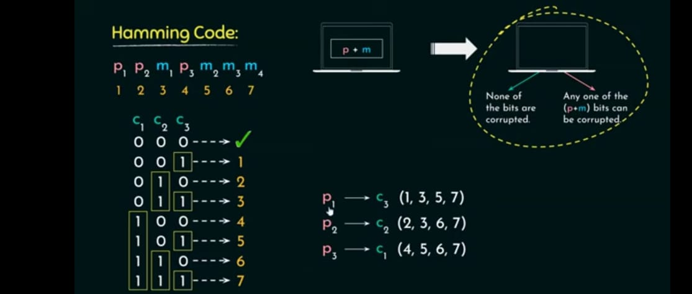

Slide 7
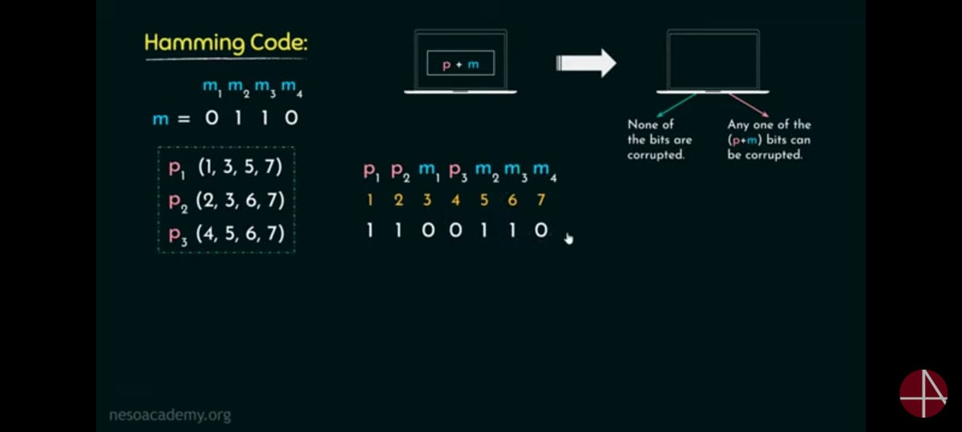

Slide 8


Slide 9
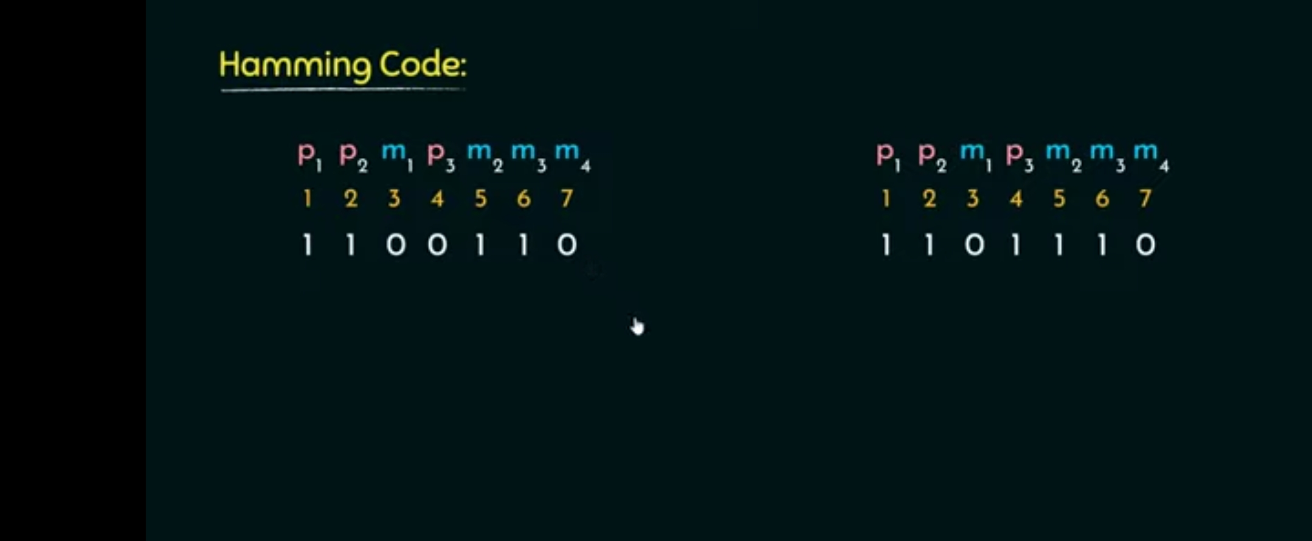

Slide 10
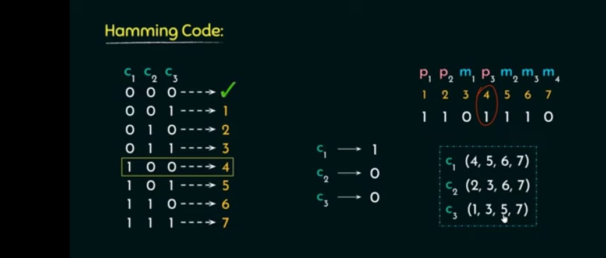

Slide 11
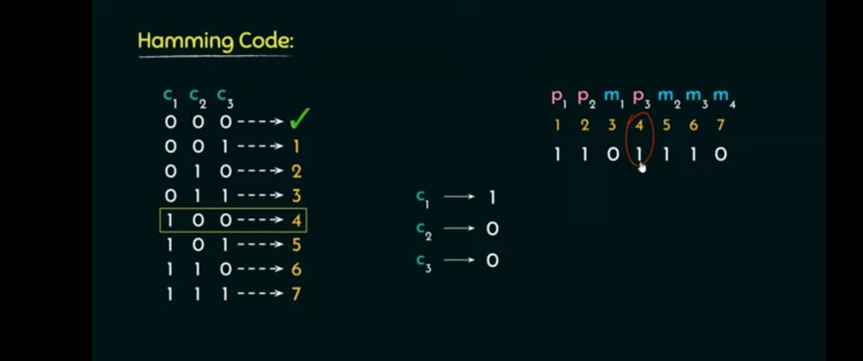

Slide 12
A four bit message, 1101 is transmitted through a network with even parity. Now, according to Hamming code policy, examine the following:
a) The code-word of the transmitter side.
b) If the receiver has received an error code where 5th bit is flipped then how the error is detected and corrected in the receiver side.

Slide 13
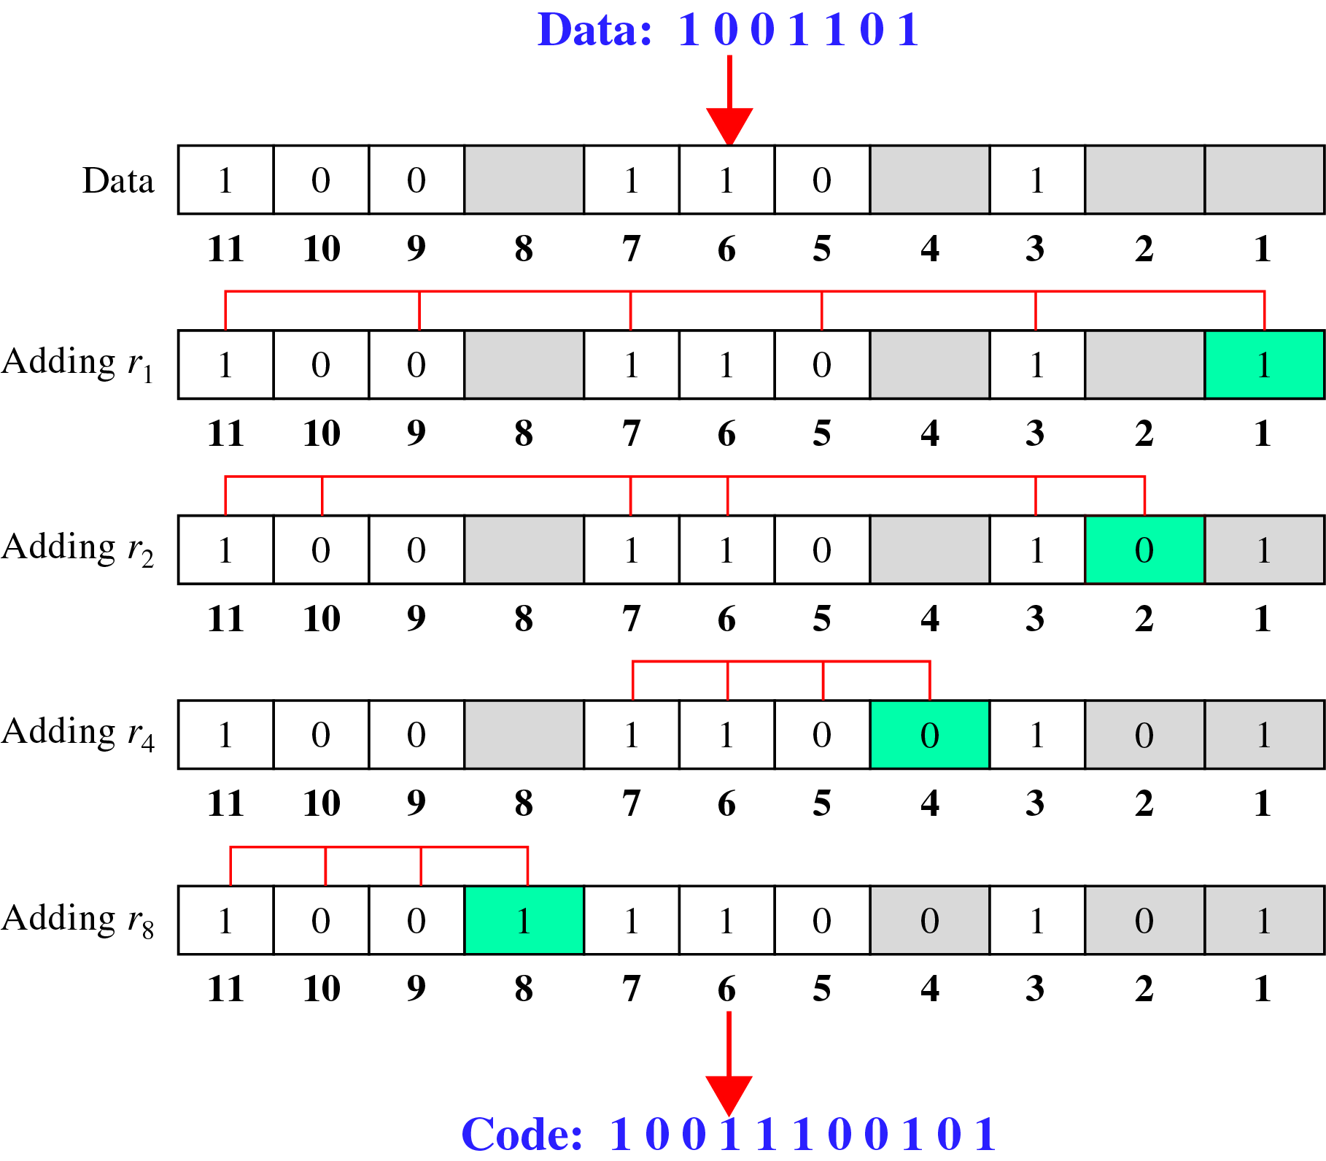
Error Correction(cont’d)
Calculating the r values
Calculating Even Parity

Slide 14
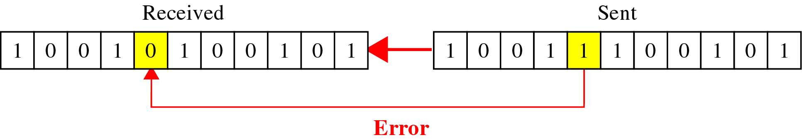
Error Correction(cont’d)
Error Detection and Correction

Slide 15
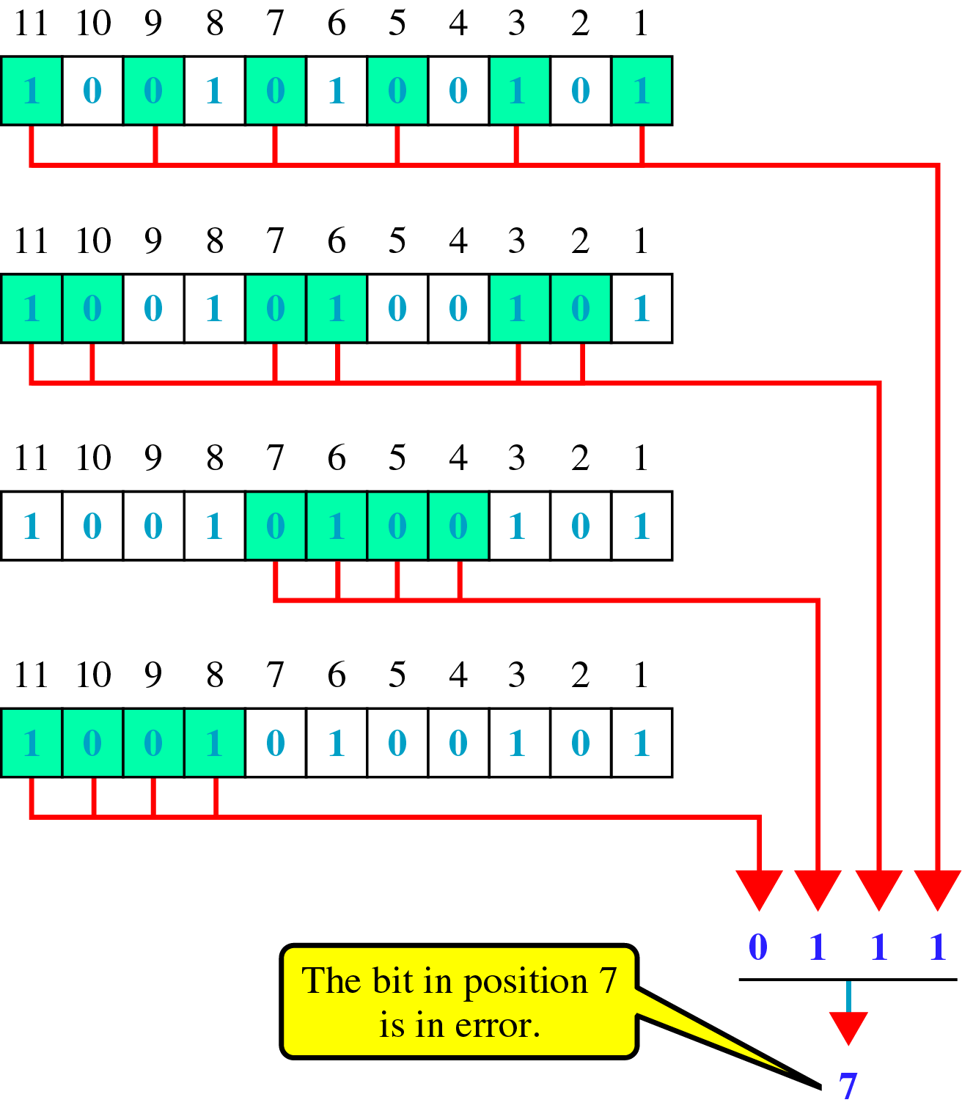
Error Correction(cont’d)
Error detection using Hamming Code

